Slide 1
AI Powered Video Summarization
Under the supervision of
Dr. Asmaa Elkholy
TA. Mariam Essam | TA. Nagham yahya
Made by
Mohamed Shady
2024 - MTI

Slide 2

Agenda
1- Introduction
2- Motivation
3- Problem Definition
4- Project Objective
5- Related Works
6- Background

Slide 3
Agenda
7- Developed Solution
8- Project Methodology
9- Experimental Results
10- Web application demo
11- Future Work
12- References

Slide 4
Introduction

Slide 5
Introduction
1.1
1.2
1.3
What is video summarization
Importance of Video Summarization
AI in video Summarization

Slide 6
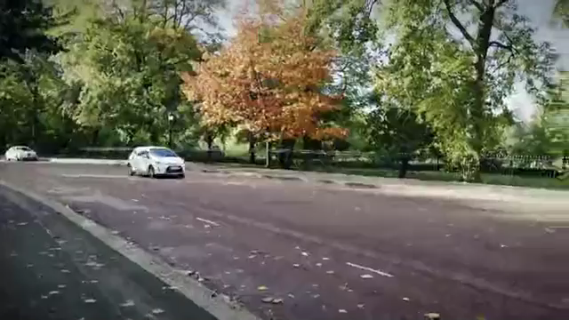
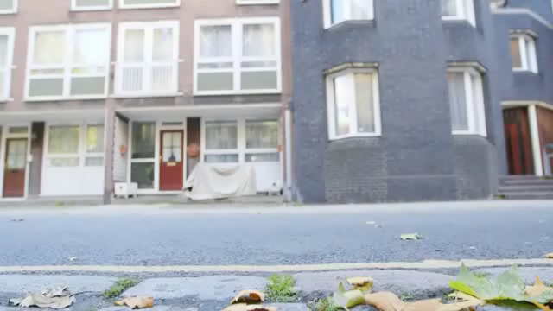
1.1-What is video summarization
Video Summarization is the process of creating a shortened version of a longer video, highlighting the important parts and removing any unnecessary content.
Original Video
Summarized Video
(2:40) minutes
25 mb
(25) seconds
4 mb

Slide 7

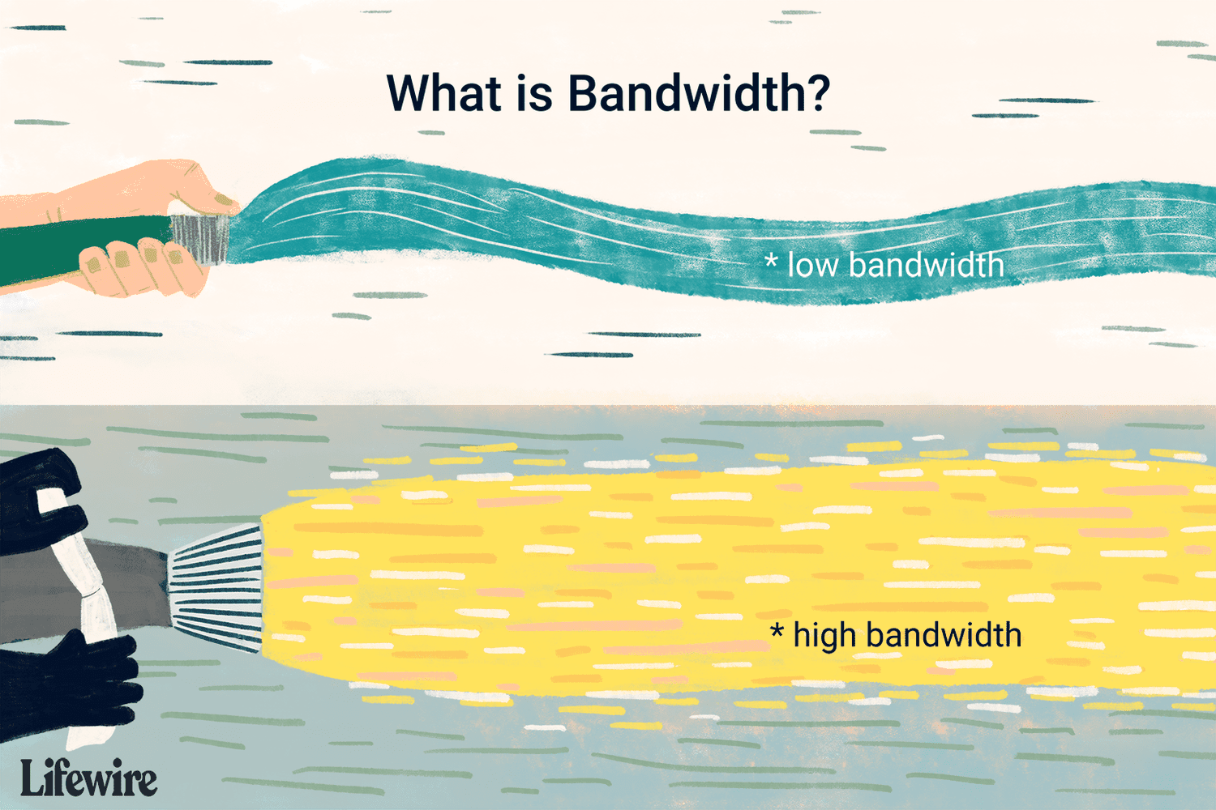
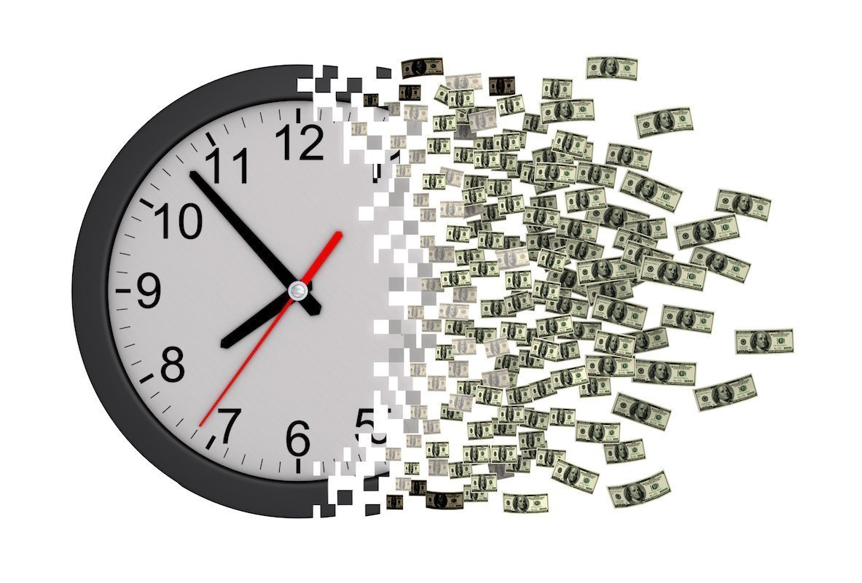
1.2-Importance of Video Summarization
Fast Understanding
Resource Optimization
Time-Saving

Slide 8

1.3-AI in Video Summarization
▪ Videos are often time-consuming to summarize.
Machine Learning helps making video summarization easier and faster.
▪ Machine Learning Algorithms enables the system to comprehend video content and generate summaries using different approaches, each designed for a specific purpose.

Slide 9
Motivation

Slide 10
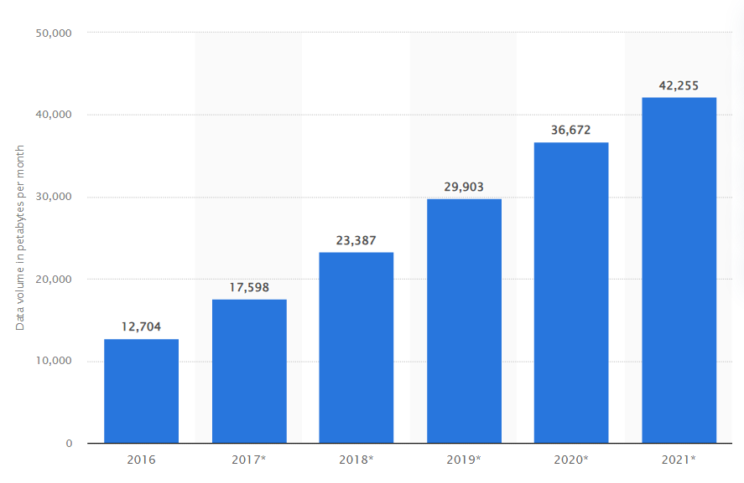
2.1-Motivation
Global increase in content volume
2018
2019
2020
2021
2022
2023
Data volume of internet videos from 2018 to 2023
(in petabytes per month) 1pb = 1000000 GB

Slide 11
Problem Definition

Slide 12
3-Problem Definition
Videos, with their complex structures and diverse purposes, pose a challenge in video summarization.
1) In previous work, video summarization had limitations in performance.
We aim to overcome this by Increasing performance and keeping the engagement of the original video.
2) Lack of available free tools for video summarization.

Slide 13
Project Objective

Slide 14
4-Project Objective
Our objective is to create a video summarization Web App with a friendly interface that can summarize videos for a wide range of users, including:
▪ Content creators.
▪ Content consumers.
▪ News and media Professionals.
- Our focus will be on tutorial, Vlogs and Commercial videos.

Slide 15
Related Works

Slide 16
6.1-Related Works
Title | Approach | Method | Dataset | F1-score
Align and Attend: Multimodal Summarization with Dual Contrastive Losses (2023) [1] | supervised | GoogleNet-RoBERTa Self Attention | Summe& TvSum | 63.4 (tv-sum)
Summarizing Videos using Concentrated Attention and Considering the Uniqueness and Diversity of the Video Frames (2022) [2] | unsupervised | GoogleNet- Self Attention | Summe& TvSum | 61.4 (tv-sum)
Robust video summarization algorithm using supervised machine learning (2022) [3] | supervised | ResNet18-BiLSTM | Summe& TvSum | 56.13 (tv-sum)
Supervised Video Summarization via Multiple features with parallel attention (2021) [4] | supervised | GoogleNet –I3D-Self Attention | Summe& TvSum | 62.8 (tv-sum)

Slide 17
)Cont.( Related Works
Title | Approach | Method | Dataset | F1-score
Combining Global and Local Attention with Positional Encoding for Video Summarization (2021) [5] | supervised | GoogleNet-Self Attention | Summe & TvSum | 62.7 (tv-sum)
DSNet: A Flexible Detect-to-Summarize Network for Video Summarization (2021) [6] | supervised | GoogleNet-Self Attention | Summe & TvSum | 62.1 (tv-sum)
Summarizing Videos with Attention (2019) [7] | supervised | GoogleNet-Self Attention | Summe & TvSum | 61.4 (tv-sum)
Deep Reinforcement Learning for Unsupervised Video Summarization with Diversity-Representativeness Reward (2018) [8] | Unsupervised | GoogleNet-BiLSTM | Summe & TvSum | 58.1 (tv-sum)

Slide 18
6.2-Related Works Conclusion
Supervised learning gave better results but limited to the datasets.
Bi-Directional RNN’s
Are effective in task of video summarization.
RNN’s structure can be entirely replaced by Self Attention.
GoogLeNet was the most common and effective feature extractor.
Kernel Temporal Segmentation (KTS) technique should be used to detect changing scenes in the video

Slide 19
Background

Slide 20
7-Background
7.1
7.2
Datasets in video summarization
Deep Learning in video summarization
7.3
Data processing for video summarization

Slide 21

7.1-Datasets
Collections of labeled data that are used to train machine learning models to make predictions or decisions.
There are multiple datasets for video summarization such as
▪ TvSum
▪ OVP
▪ YouTube Dataset
▪ SumMe
- TvSum & SumMe are considered as the most common benchmark datasets.

Slide 22
(Cont.) Datasets
Dataset | No of Videos | Content | No. of annotators | Annotations Type
TVSum | 50 | News, How-to’s, vlogs (10 categories-5 videos each) | 20 | Key fragment-scores
OVP | 50 | Documentary, educational historical | 5 | Sets of key frames
Youtube | 50 | Cartoons, sports, tv-shows | 5 | Sets of key frames
SumMe | 25 | Holidays, events, sports | 15-18 | Sets of key frames
- We found that TvSum have the most no. of videos and the no. of annotators.

Slide 23
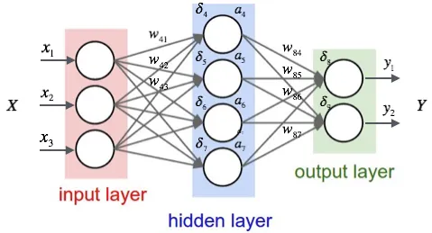
7.2-Deep Learning in video summarization
It is a subset of machine learning that uses neural networks to learn from data.
Deep learning can handle complex data, such as images, text, and speech, and can achieve high performance in many complex tasks.
Neural network example

Slide 24
(Cont.) Deep Learning in video summarization
Most common Deep learning Architectures used in video summarization
Convolutional Neural network
Recurrent Neural Network
Self Attention Mechanism
LSTM
GRU

Slide 25

(Cont.) Deep Learning in video summarization
▪ Convolutional Neural Networks
CNN is designed to automatically learn features by using multiple filters.
It is used in Image Recognition, Image classification.
▪ CNN’s extract features (edges, objects,..) from video frames to help in video summarization.
Convolutional
Neural network example

Slide 26
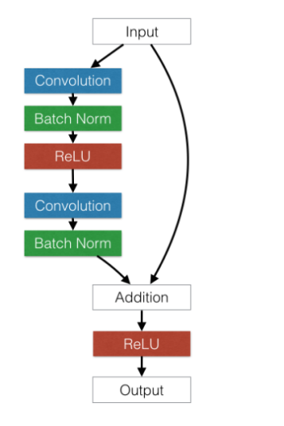
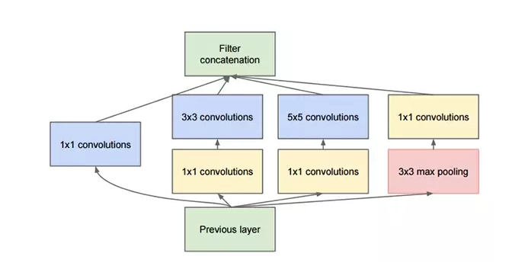
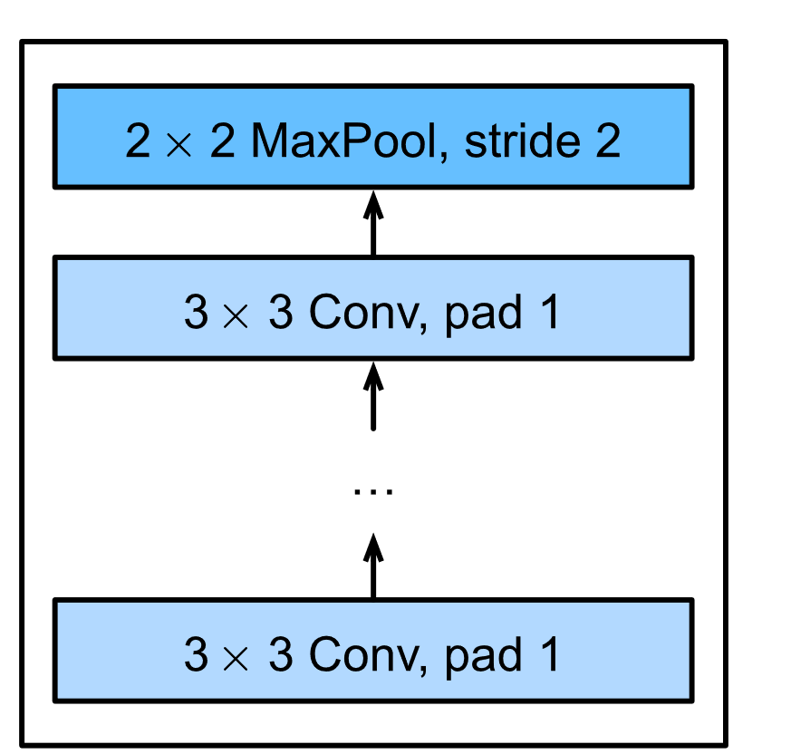
▪ Most common CNN’s architectures
(Cont.) Convolutional Neural Networks
Model | ResNet | GoogleNet | VGG
Key Feature | Uses the shortcut connections which allow the network to go deeper in the network. | Uses inception modules. which are blocks of convolutional filters with different sizes. | constructed with small convolutional filters (3x3)
Top 5 Accuracy | (ImageNet) 92.8% | (ImageNet) 93.7% | (ImageNet) 90.0%

Slide 27

(Cont.) Deep Learning in video summarization
▪ Recurrent Neural Networks
RNN is designed to process sequences of data.
It saves the output of a layer and feeds it back to the input to predict the next output.
It is used in Time series data, voice, and video.
▪ RNN’s can process video frames or frame features to predict the frame importance.
Recurrent Neural network example

Slide 28
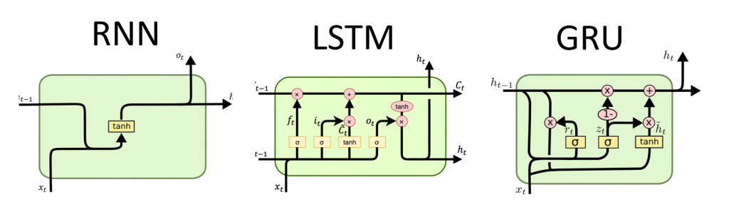
(Cont.) Recurrent Neural Networks
▪ What is Long-Short-Term-Memory
LSTM is a variation of the recurrent neural networks that was created to enhance RNN’s ability for capturing long-term dependencies.
It can be used to analyze video by learning the relationships between Video frames.
Forget gate
Output gate
Input gate

Slide 29
(Cont.) Recurrent Neural Networks
▪ What is Gated Recurrent Units
GRU is a simplified version of the LSTM that is easier to train and faster to run.
GRUs are more effective at tasks that require the network to learn quickly and adapt to new inputs.
Reset gate
Update gate

Slide 30
(Cont.) Deep Learning in video summarization
▪ What is Self-Attention
It is a type of attention mechanism, quantifies relationships between all inputs in a sequence, enhancing context understanding in models.
Used in
Natural Language
Processing
Create three vectors from each of the input values (query, key, value) .
Calculate a score for how much to focus on each part of the input
Computer Vision tasks

Slide 31
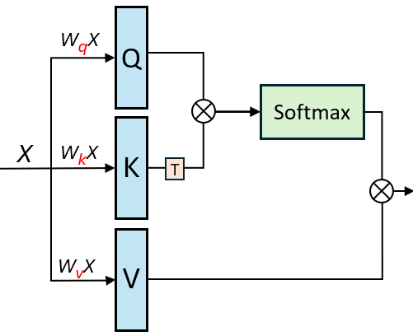
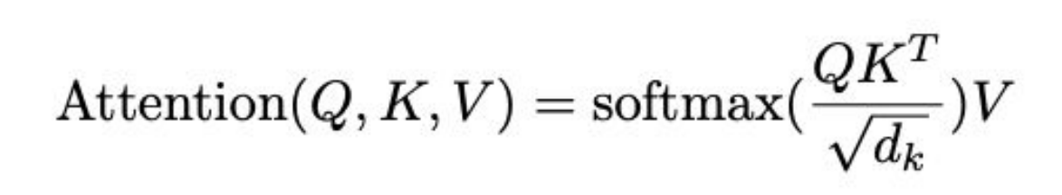
(Cont.) Deep Learning in video summarization
▪ How Self Attention Works:
Each frame (query) is compared to all others (key) to determine similarity scores.
Higher scores highlight greater frame relevance or similarity.
Attention scores weight frame features (values) to establish importance of frames in the summary.

Slide 32
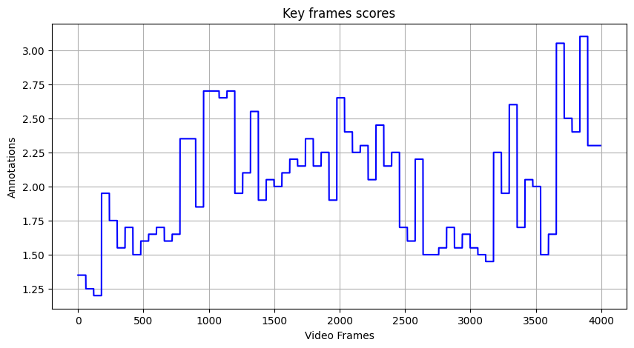
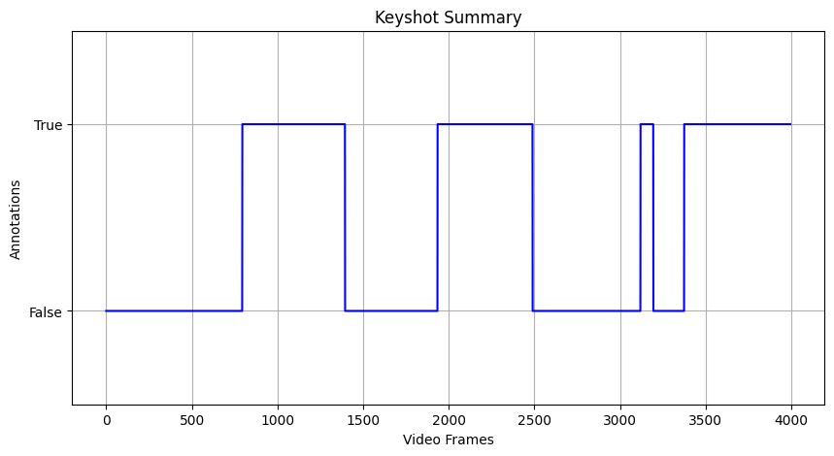
7.3-Data processing in video summarization
following related works datasets that contains labels as keyframe scores need to be converted to keyshot summaries to provide meaningful labels for video summarization.

Slide 33
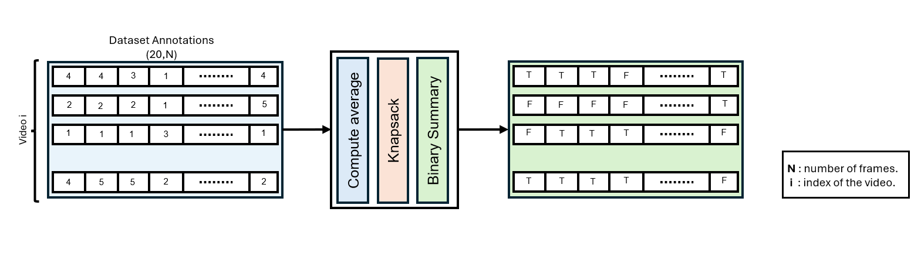
(cont.) Data processing
▪ To convert the frame scores to keyshot summary we follow 3 steps Compute average across change points, preform knapsack, Convert to binary summary.

Slide 34
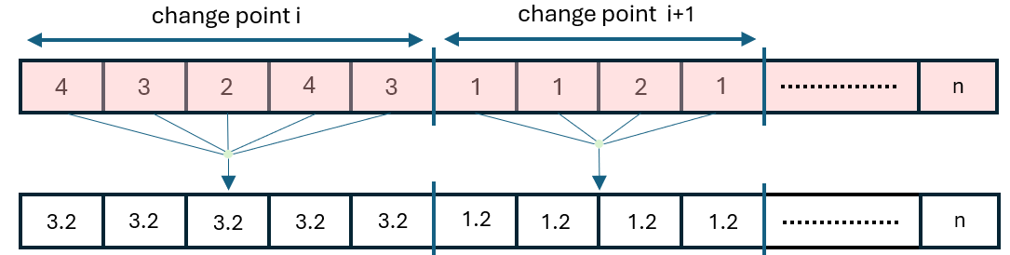
(Cont.) Data processing
1) Average score across change points (scenes) is computed and the scores are overwritten by the average score of the entire segment.
▪ change points are detected using the kernel temporal segmentation (kts) algorithm.

Slide 35
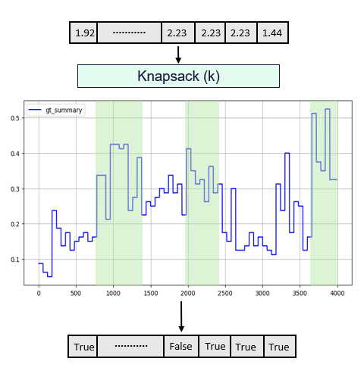
(Cont.) Data processing
2) After the scores are averaged the knapsack algorithm picks The segments with the highest scores these segments shouldn’t exceed a certain proportion of the original video K.
3) The picks of the knapsack algorithm is then considered true, and the other segments are false and that produces the binary key shot summary.

Slide 36
Developed Solution

Slide 37
9-Developed Solution
9.2
9.3
9.1
Our Contribution
Model Choice
Model Architecture

Slide 38
9.1-Our Contributions
we processed the tvsum dataset and extracted our own features to increase model performance.
Carried out 6 experiments using Bi-Lstm, Bi-Gru, Self-Attention on public dataset and our processed dataset.
Tuned the hyperparameters of the Self attention model to give better results.
Developed a web application with easy-to-use interface to help users summarize videos fast and free.

Slide 39
9.2–Model Choice
After conducting many experiments, we found that the best architecture includes
▪ We used GoogleNet CNN to extract 1024 features from each frame in the video.
▪ utilized Self-Attention Layer to capture contextual relationships between video frames.
▪ Added a Dense Layer with 1024 neurons followed by the output layer to compute frame importance scores.

Slide 40
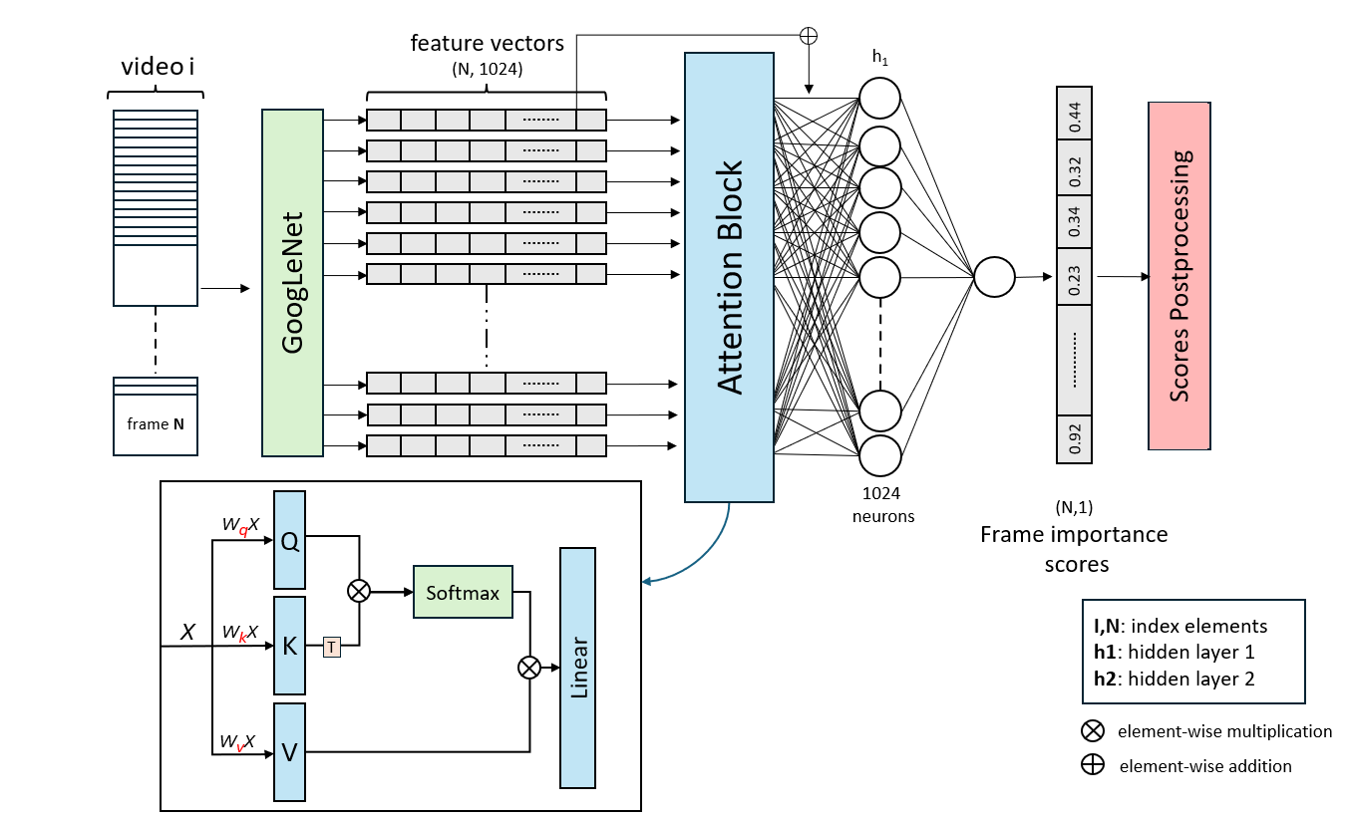
9.3–Model Architecture

Slide 41
Methodology

Slide 42
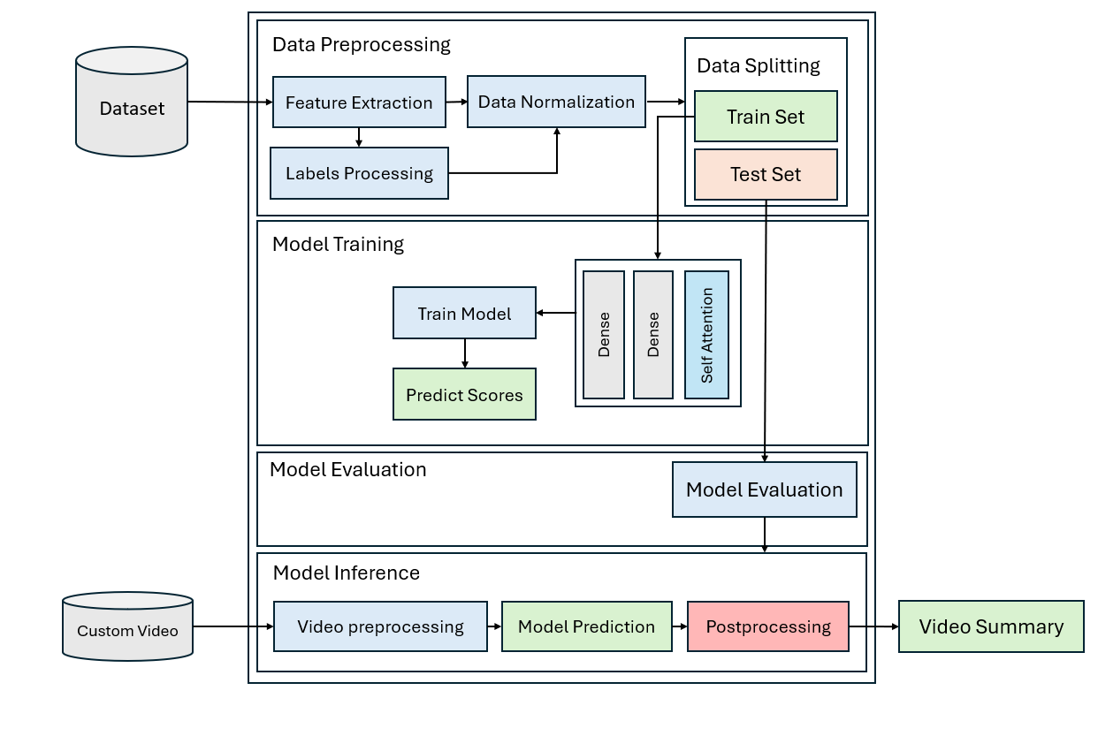
10.1-Block Diagram

Slide 43
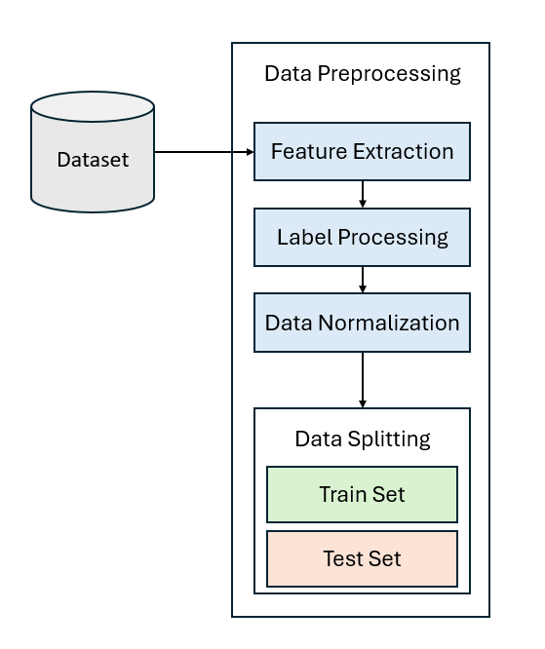
10.2.1-Data preprocessing
After extracting image frames and labels, we do the following.
Extract features using GoogLeNet CNN.
Convert frame scores to key shot summaries.
Normalize features and labels.
Splitting data into 5 cross validation splits.

Slide 44
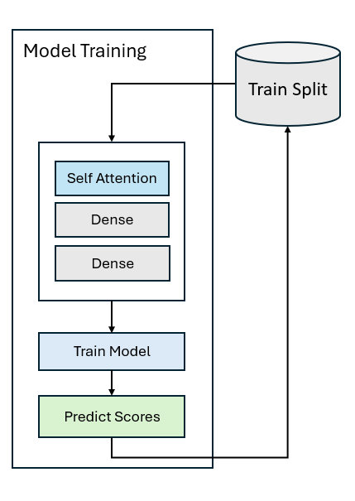
10.2.2-Model Training
▪ We start training model on the 5 train splits each split is trained for several training epochs in each epoch the model tries to predict the scores of the video frames.
▪ During training, the loss function measures its prediction errors and applies gradient descent to adjust model weights, iteratively enhancing model prediction results.

Slide 45
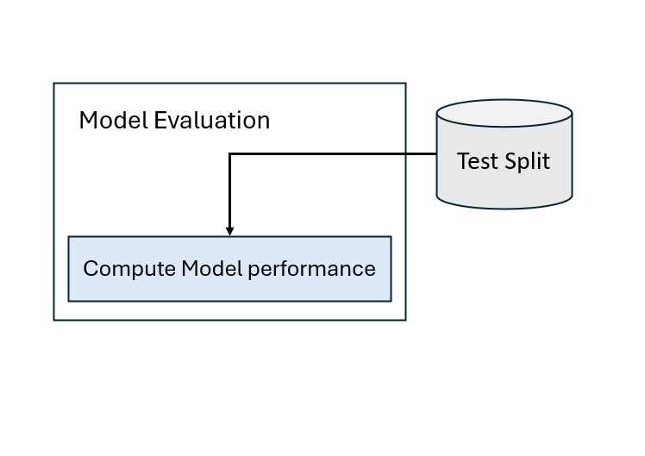
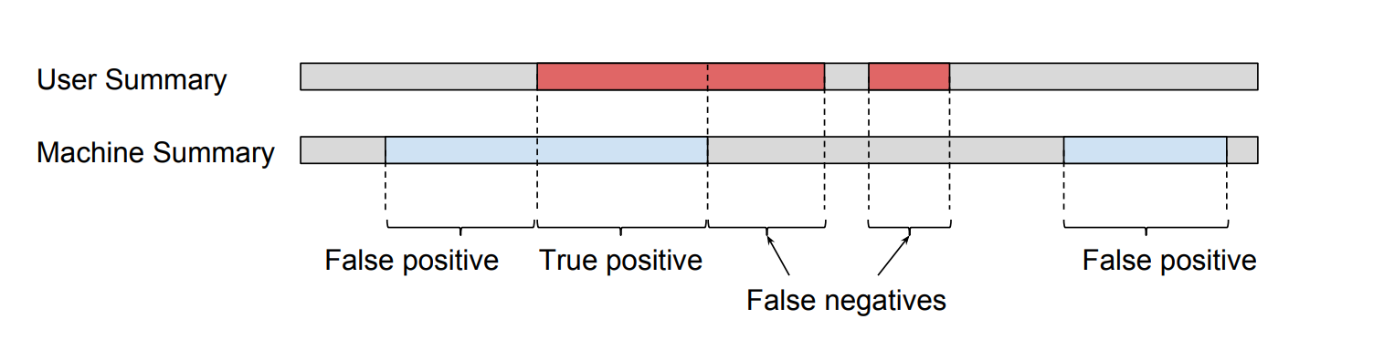
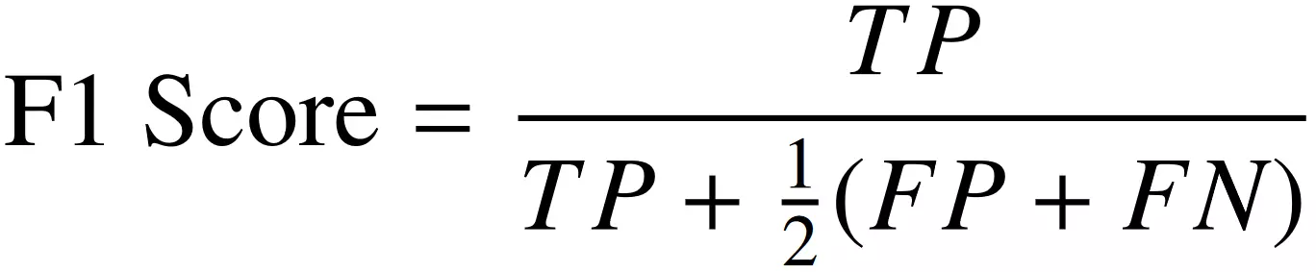
10.2.3-Model Evaluation
▪ In Model evaluation we use F-score metric to compare the predictions of the model to the ground truth labels in the test split.

Slide 46
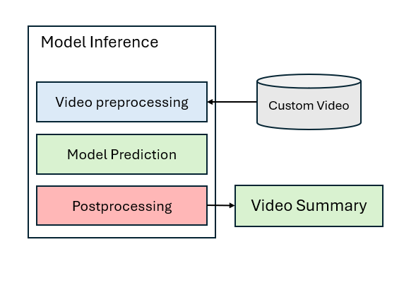
10.2.4-Model Prediction
▪ For testing the model with custom video, we do 3 steps
Preform video preprocessing
Get model prediction scores.
Use the frame scores to generate a video summary.

Slide 47
Experimental Results

Slide 48
11-Experimental Results
11.4
11.5
11.1
Overview
11.2
Experiments Hyperparameters
11.3
Public Preprocessed Dataset Experiments
Our processed Dataset Experiments
Conclusion

Slide 49
11.1-Experiments Overview
▪ We carried out 2 sets of experiments preprocessed public dataset and our processed dataset on three different architectures BI-LSTM, BI-GRU, Self Attention
▪ Each Result is recorded with its respective f-score we also show the results of testing the model with a video from the dataset to ensure that the model is learning patterns within the data.

Slide 50
11.2-Experiments Hyperparameters
▪ We used the following hyperparameters for the following experiments to ensure fair comparison results.
Activation | Epochs | Batch size | Optimizer | Learning Rate | Weight Decay
Relu | 120 | 1 | Adam | 0.00005 | 0.00001

Slide 51
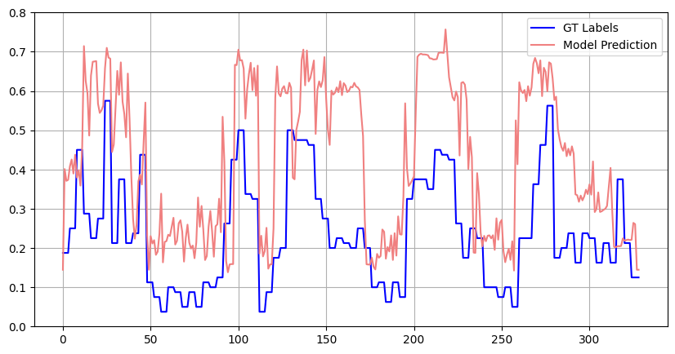
11.3-Public Dataset Experiments (No processing)
Model | Fscore | Loss
BI-GRU | 61.7 | 0.051
BI-LSTM | 62.4 | 0.049
Self Attention | 62.8 | 0.048
▪ The Self Attention model outperforms both BI-LSTM and BI-GRU by 0.4% and 1.1%, respectively.
Model = Self Attention
Split-no = 0
Vid-no = 43
▪ The model shows unstable and inaccurate predictions when compared to the ground truth labels .

Slide 52
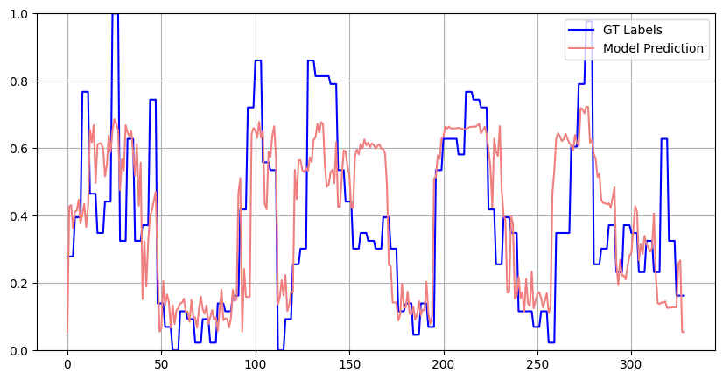
11.4-Our processed Dataset Experiments
Model | Fscore | Loss
BI-GRU | 64.7 | 0.052
BI-LSTM | 66.2 | 0.051
Self Attention | 67.3 | 0.045
▪ The Self Attention model outperforms both BI-LSTM and BI-GRU by 2.6% and 1.1%, respectively.
Model = Self Attention
Split-no = 0
Vid-no = 43
▪ Using Our Dataset the model shows stable and accurate predictions when compared to the ground truth labels.

Slide 53
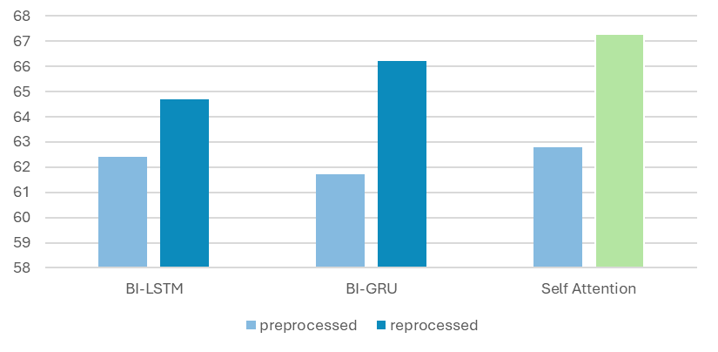
11.5-Experiments Conclusion
▪ Our processed dataset showed better Fscore by 3% on average and the Self Attention model architecture gave the best results.

Slide 54
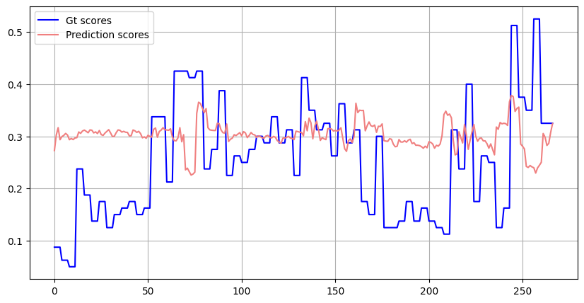
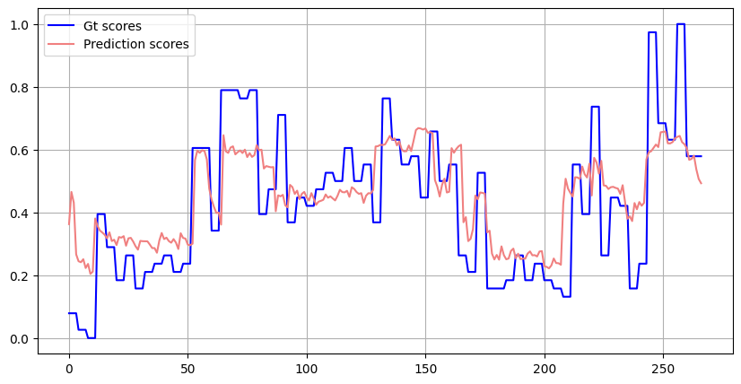
(cont.) Experiments Conclusion
▪ Prediction Comparison
The model trained on the public dataset showed poor prediction results due to feature misalignment. However, custom feature extraction improved prediction performance by 13%.
f-score = 53
split-no = 0
vid-no = 10
f-score = 66
split-no = 0
vid-no = 10
Public Preprocessed Dataset
Our Processed Dataset

Slide 55
(Cont.) Conclusion
▪ Comparison with previous work
Paper | Dataset | Model | F-score
Deep Reinforcement Learning for Unsupervised Video Summarization with Diversity-Reward. | TvSum | BI-GRU | 57.8
 |  | BI-LSTM | 58.1
Discriminative Feature Learning for Unsupervised Video Summarization | TvSum | BI-LSTM | 58.8
DSNet: A Flexible Detect-to-Summarize Network for Video Summarization | TvSum | BI-LSTM | 60.8
 |  | Self-Attention | 61.2
Combining Global and Local Attention with Positional Encoding for Video Summarization | TvSum | Self-Attention | 62.7
Align and Attend: Multimodal Summarization with Dual Contrastive Losses | TvSum | Self-Attention | 63.4
Ours | TvSum | BI-GRU | 64.7
 |  | BI-LSTM | 66.2
 |  | Self-Attention | 67.3

Slide 56
Web Application Demo

Slide 57

12-Application Demo

Slide 58
Future work

Slide 59
6.2-Future Work
Enhance model training by leveraging diverse datasets encompassing various video types.
Add a hybrid approach that uses text & video to capture the full meaning in the summarization
Use specific keywords to focus on certain parts/events of the original video
Provide configuration settings for each summary (Quality, Audio, Length)
Develop a mobile application to target a wider range of users

Slide 60
References

Slide 61
15-References
"Doe, J., & Smith, A. (2021). Align and Attend: Multimodal Summarization."
"Doe, A., & Green, L. (2019). Summarizing Videos using Concentrated Attention."
"Lee, C., & Kim, H. (2021). Robust Video Summarization using Supervised Machine Learning ResearchGate."
"Brown, T., & Adams, S. (2021). Supervised Video Summarization via Multiple Features."
"Zhang, Y., & Wang, X. (2021). Combining Global and Local Attention with Positional Encoding. IEEE International Symposium on Multimedia (ISM)."
"Patel, K., & Singh, M. (2021). DSNet: A Flexible Detect-to-Summarize Network for Video Summarization."
"Garcia, P., & Lee, D. (2019). Summarizing Videos with Attention."

Slide 62
Thank you …

